Slide 1
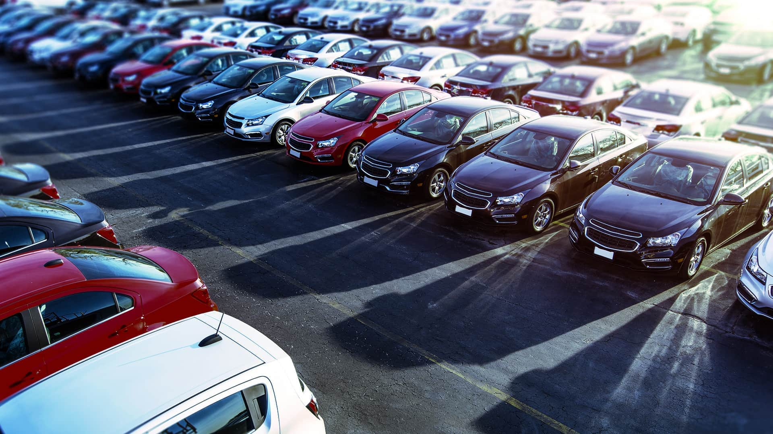

Predicting Used Car Prices
By Zack DeNoto
https://www.bohautoplex.com/images/styles/s59r_fxslide1.jpg

Slide 2
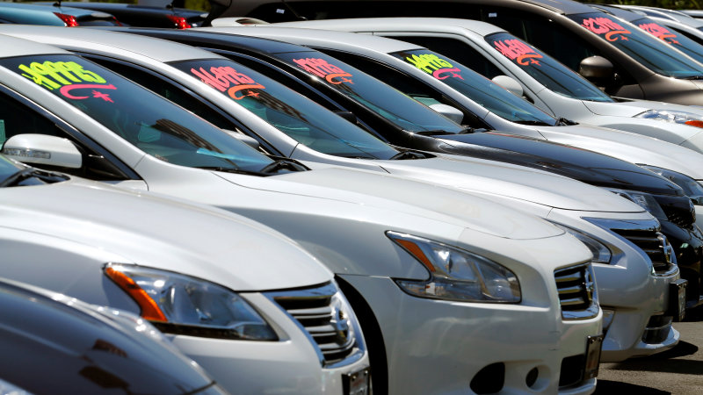
Intro/Hypothesis
Used Car Prices
Biggest Factors
How accurate?
https://nine-thrive.com/wp-content/uploads/2019/08/RTX2R7DY.jpeg
Notes:
US dataset- 38.5k rows
Small auction dataset- 2,500 rows
Craigslist dataset- 458k rows

Slide 3
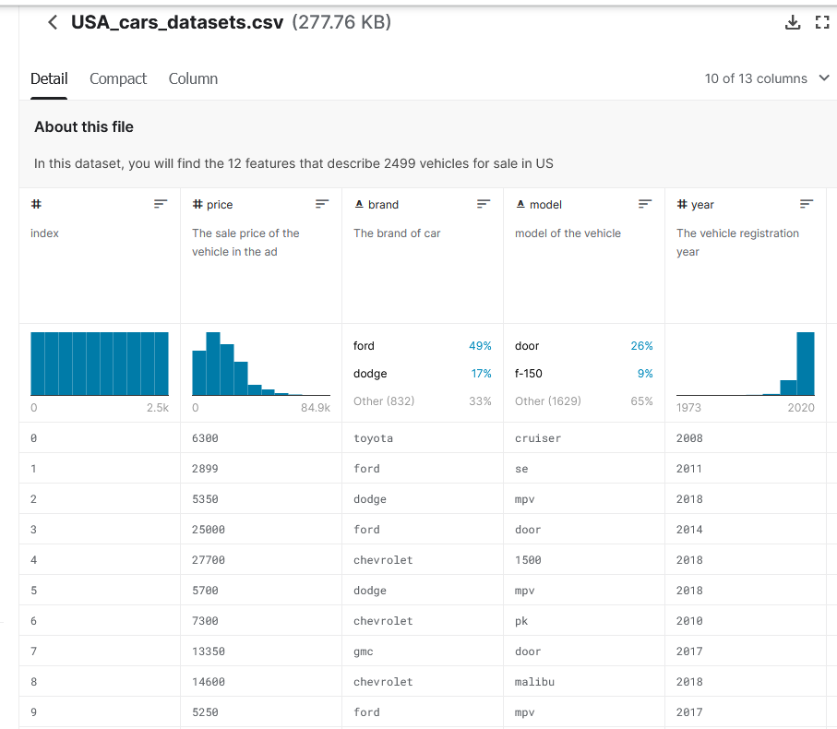
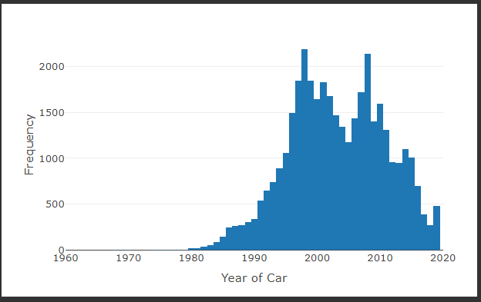
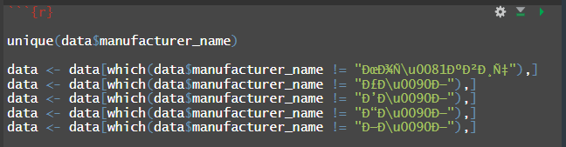
EDA
Datasets used
Steps needing to be done
Challenges
Notes:
US dataset- 38.5k rows
Small auction dataset- 2,500 rows
Craigslist dataset- 458k rows

Slide 4

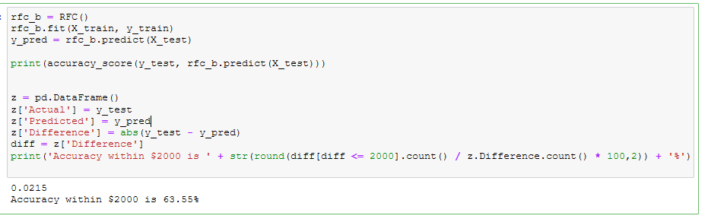
Modeling
AdaBoost
K-Nearest Neighbor
Naives Bayes
Random Forest
Ridge Regression
XGBoost
https://www.smartdatacollective.com/wp-content/uploads/2020/03/data-modeling-tools.jpg

Slide 5
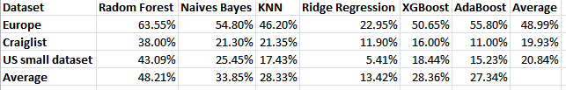

Results
Accuracy
Correlation
Differences in data
https://cms-static.wehaacdn.com/documentmedia-com/images/bullseye.1166.jpg
Notes:
Europe-odometer -.492
Europe-year .868
Europe-number of photos .313
Europe-odometer 0.044
US Auction-year .477
US Auction-milage -.527
Craigslist-year .492
Craigslist-mileage -.491

Slide 6

Conclusion
Problems in the Analysis
How does this impact the field?
How can this be improved?
https://blog.thecenterforsalesstrategy.com/hs-fs/hubfs/Question-marks-1.jpg?width=632&height=278&name=Question-marks-1.jpg

